Slide 1
JTTRI-JITTI Global Seminar Series
A Rapidly Changing Post Pandemic World Order
and the New Japan-U.S. Relationship Hereafter
December 13th 10-11:30am (JST) / December 12th 8-9:30pm (EST)
Online (Zoom webinar)
Fee: Free
Simultaneous Interpretation (English-Japanese)
Overview
The international situation is changing drastically in the post-COVID era. In addition to unforeseen and serious situations such as the invasion of Ukraine by Russian forces, the relationship between the U.S. and China is changing into a competitive one as a result of China's aggressive maritime expansion.
Under these circumstances, some countries that are in favor of the concepts of (1) promoting and entrenching the rule of law, freedom of navigation, and free trade, (2) pursuing economic prosperity, and (3) ensuring peace and stability are emerging, while other countries are emphasizing relations with China and Russia, which are promoting changes in the status quo through force.
At a time when the international order is undergoing rapid change, it is very important to discuss how the Japan-U.S. relationship, which has always been the most important bilateral relationship, should evolve to a new dimension. In addition to government-to-government diplomacy, people-to-people exchanges between the two countries have played a key role in the foundation of the Japan-US relationship, covering multiple layers and a wide range of areas including business, academia, culture, education, and tourism. However, since COVID has forced people to communicate virtually, it is necessary to reconsider the significance of the Japan-US relationship and reconstruct it at a higher level.
In the seminar, we have two of the most knowledgeable and experienced experts on diplomacy and security in the U.S. and Japan to speak on these topics.

Slide 2
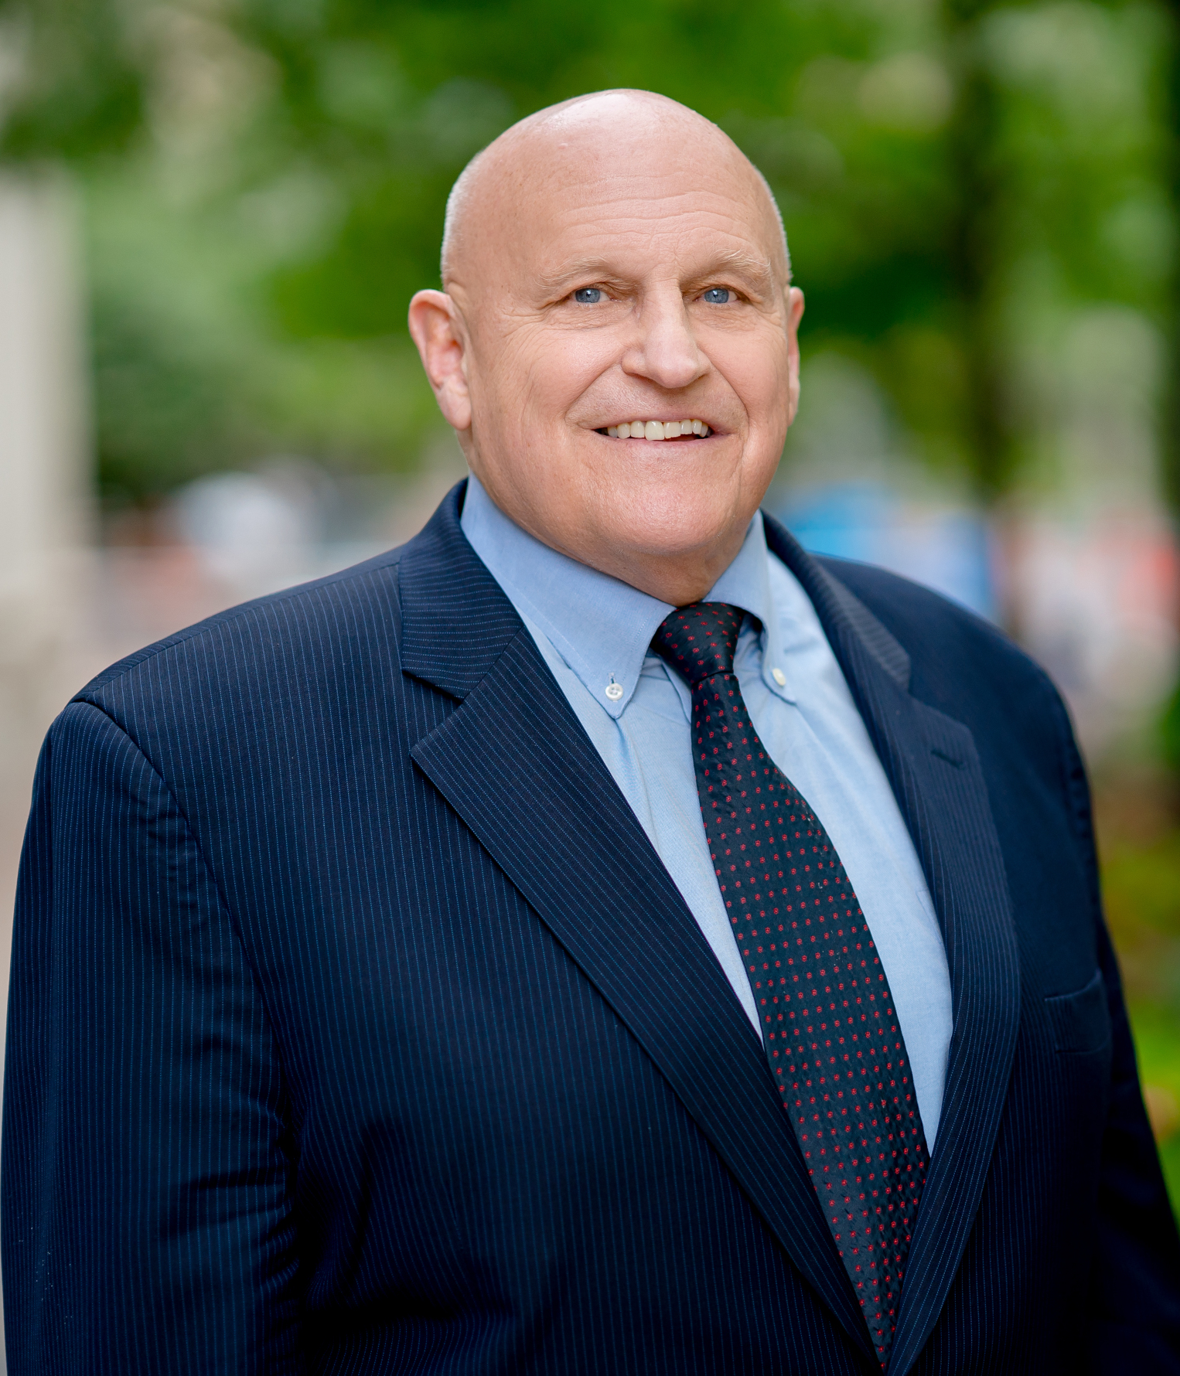
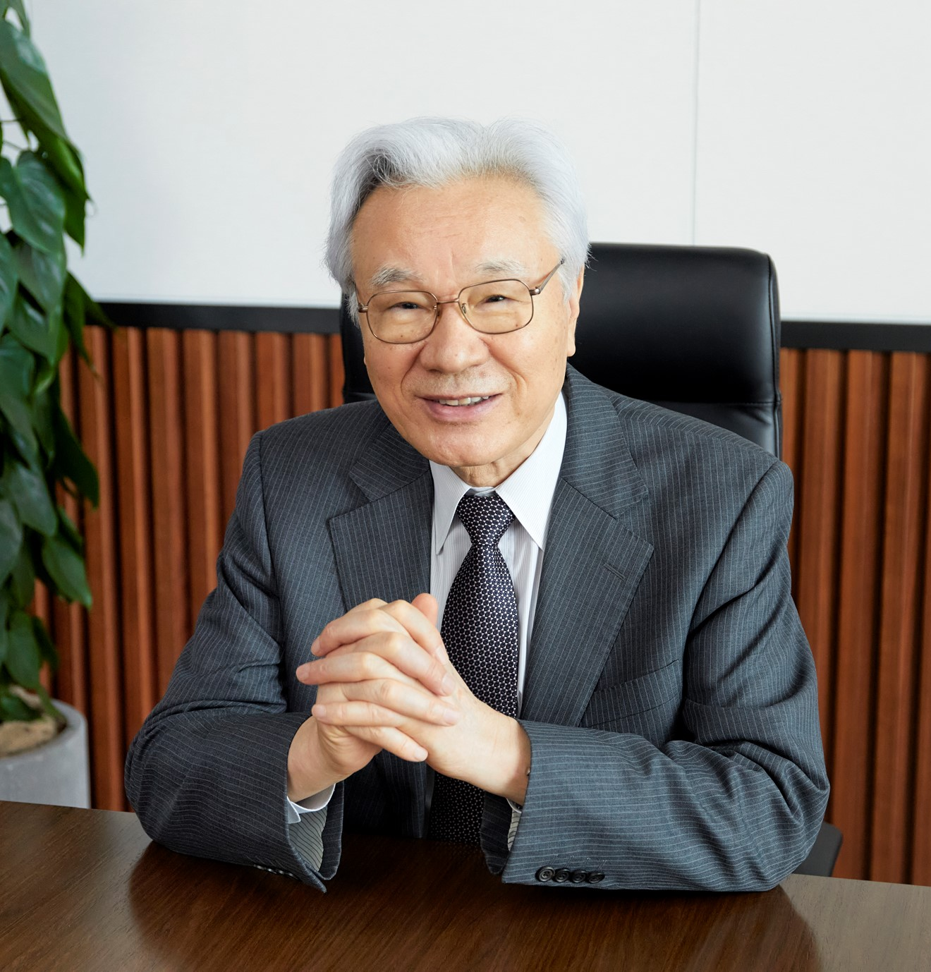
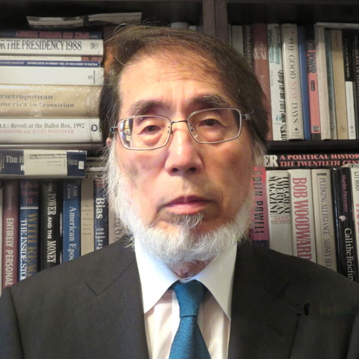
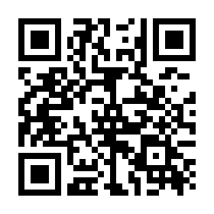
Program
1 Opening Remarks:
Masafumi SHUKURI Chairman, JTTRI
Keynote Speech:
３ Discussion:
Moderated by Yoshikatsu SUZUKI
Distinguished Research Fellow,
The Japan Forum on International Relations, Inc
４ Closing Remarks:
Tetsuya OKUDA President for International Affairs, JTTRI
President, JITTI
Richard L. Armitage
Former Deputy Secretary of State
President, Armitage International
Shotaro YACHI
Former Secretary General of the National Security Secretariat
Former Vice Minister for Foreign Affairs
President, Fujitsu Future Study Center
Registration
Please register at the URL below by Dec. 8th:
https://krs.bz/jterc/m/seminar221213english
We will send the URL for viewing by Dec. 12th.
Japan Transport and Tourism Research Institute (JTTRI) [Japan] collo2@jttri.or.jp https://www.jttri.or.jp/ Japan International Transport and Tourism Institute, USA (JITTI) [USA] contact@jittiusa.org https://www.jittiusa.org/

